Slide 1
THE NEW GOLDEN AGE : DISRUPTING THE STUDIO SYSTEM THROUGH DATA DRIVEN PRDUCTION
Abel Aleu Chol Garang
Carolyne Githenduka
Collins Wambu
Bobbin Bodo
Yvonnie Muthoni

Slide 2
Business Objective
-Identify what film genres perform best
-Identify films with high ROIs
-Movie trends analysis
-Movie performance based on release dates
-Movie perfonce based on market selection i.e Domestic vs Foreign
-Movie ratings performance

Slide 3
Dataset Overview
The MovieDB
The Numbers
IMDB SQLite Database
Box office Mojo (CSV) file

Slide 4
Data Preparation
Dropped columns not relevant for our analysis
Removed duplicates
Converting expenditure and revenue columns to numeric values
Handled missing values in critical columns
Standardization
Merging datasets for analysis

Slide 5
EXPLORATORY DATA ANALYSIS
Feature Engineering: Profit and ROI
Profit and ROI were engineered to support business-focused analysis, where profit is calculated as worldwide gross minus production budget, and ROI measures returns relative to the budget.
IMDb Ratings Filtering (Quality Control)
IMDb ratings can be unreliable with low vote counts, so only movies with at least 1,000 votes were retained to ensure more credible and stable ratings.

Slide 6
EXPLORATORY DATA ANALYSIS
Resolving Duplicate Titles in IMDb
IMDb includes multiple entries with the same title but different IDs. To avoid duplication, only the most popular version of each title was retained, defined by the highest number of votes.
Normalizing Genres (One Genre per Row)
The code converts multi-genre movie entries into a normalized, one-genre-per-row format so that each genre can be analyzed independently. This enables accurate genre-level comparisons of rating

Slide 7
EXPLORATORY DATA ANALYSIS
Title Alignment for Merging
To ensure accurate merging across datasets, movie title columns were standardized by using consistent naming, applying Title Case, and removing extra white space.
Creating Merge-Ready Tables
Multiple movie datasets were combined into a single, clean table for analysis by merging Box Office Mojo, The Numbers, IMDb, and TMDB step by step.

Slide 8
EXPLORATORY DATA ANALYSIS
Box Office + Budget Data
Box Office Mojo revenue data (bom) was merged with production budgets from The Numbers (tn) using the title_clean column. An inner join was applied so that only movies present in both datasets were retained.
Add IMDB Ratings
Next, IMDb ratings and vote counts were added by merging with the IMDb dataset using title_clean as the key. An inner join was applied to retain only movies that have both financial data and ratings.

Slide 9
EXPLORATORY DATA ANALYSIS
Merge TMDB Metadata
TMDB metadata, including genres, runtime, and popularity, was added by performing a left join with movies_with_ratings. This ensures all movies with financial and IMDb data are retained, even if some TMDB information is missing.

Slide 10
EXPLORATORY DATA ANALYSIS
Resolving Inconsistent Year Columns into a Single Release Year after merging tables
To ensure a consistent and reliable release year for each movie, multiple year sources were cleaned and consolidated. The original year and start_year columns were first converted to numeric values, coercing invalid entries to missing values. A new year column (tn_year) was then extracted from the release_date field using datetime conversion. A unified release_year column was created by prioritizing the most reliable source (tn_year), with fallback to start_year and then year where necessary. After verification, the redundant year columns were removed, leaving a single clean release_year variable for analysis and visualization.

Slide 11
Key Preliminary Insights (Pre-EDA)
-High budgets do not guarantee high ROI.
-Genres like Animation, Adventure, and Action dominate worldwide revenue.
-Foreign markets contribute a significant portion of total revenue.
-Longer runtime do not necessarily increase profitability.
-Higher IMDb ratings are associated with higher revenue, but only for sufficiently popular films.

Slide 12
Key Preliminary Insights (Pre-EDA)
-Avoid over-investing in excessively long runtimes.
-Use IMDb ratings as a quality signal, considering only movies with high vote counts.
-Favor mid-budget productions to manage financial risk effectively.

Slide 13
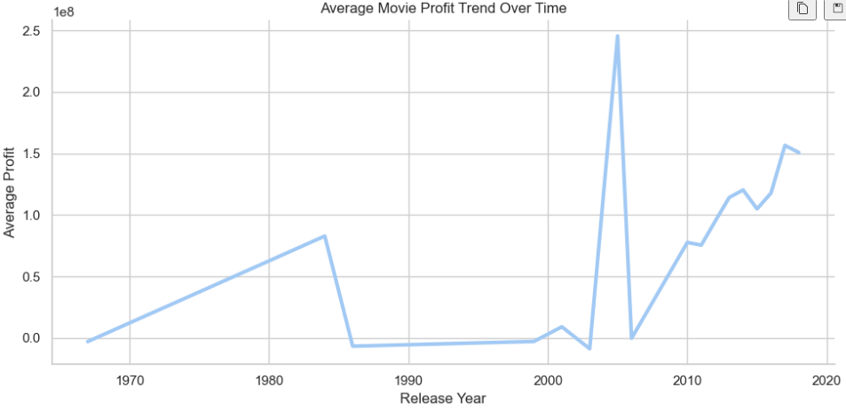
Average Movie Profit Trend Overtime

Slide 14
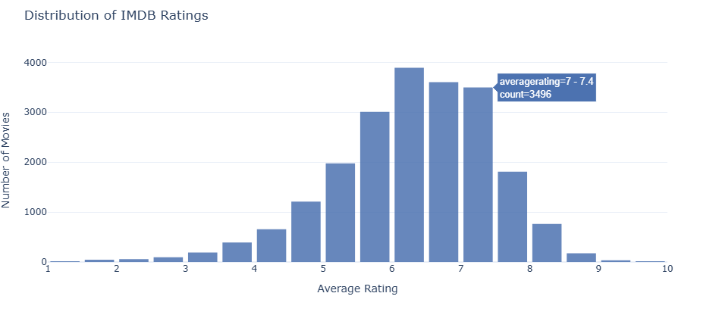

Slide 15
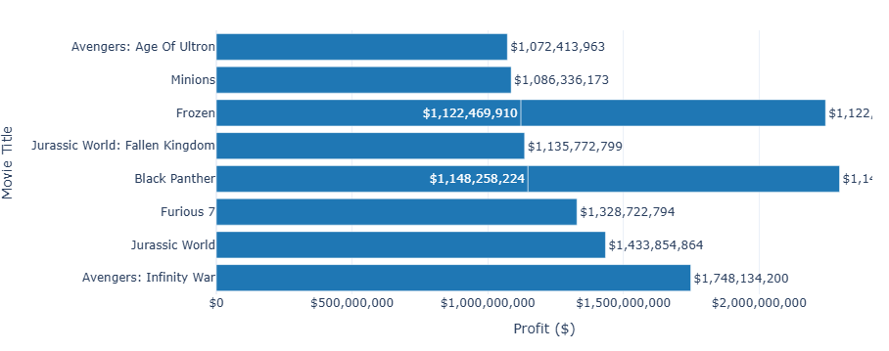
Top 10 Most Profitable Movies This chart highlights the top 10 movies by profit. Investors can see which titles generated the highest returns and which studios are leading in profitability.

Slide 16
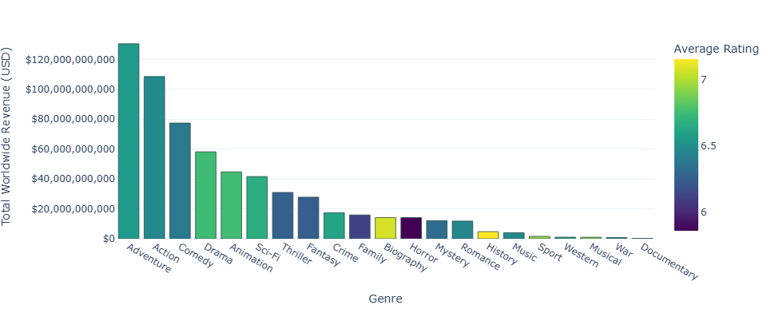
Total Worlwide Revenue by genre

Slide 17
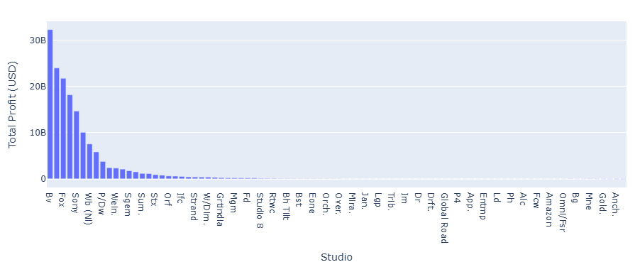
Total Profit by Studio

Slide 18
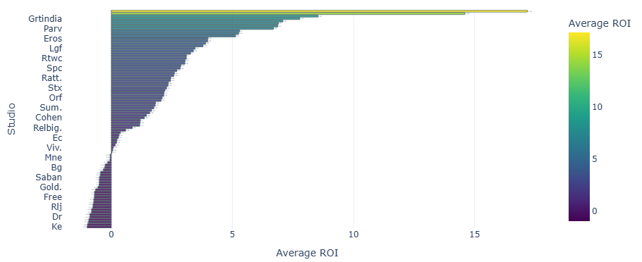
Average ROI by Studio

Slide 19
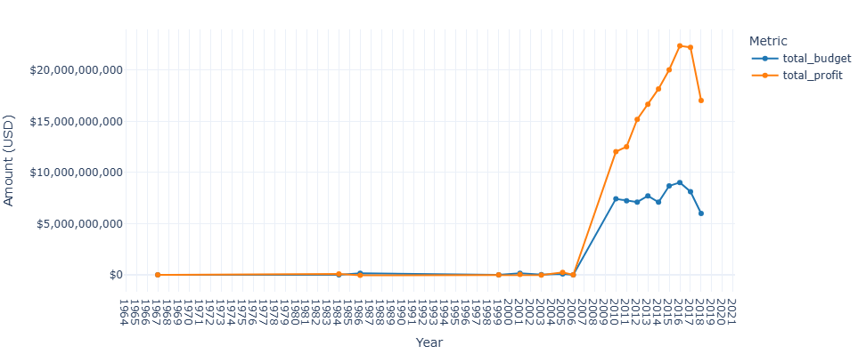
Total Production Budget and Profit by year allows stakeholders to see how overall spending and profitability have changed over time.

Slide 20
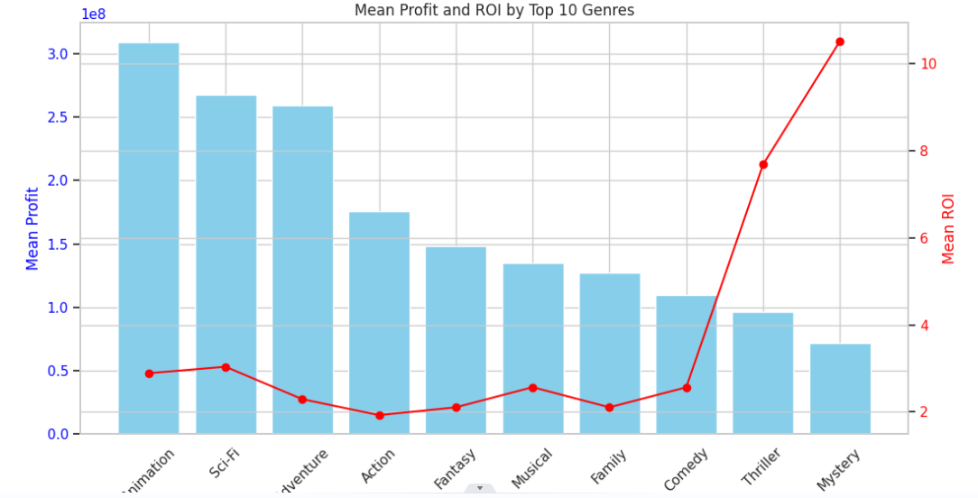
Mean Profit and ROI by Top 10 Genres

Slide 21
Key Takeaways from Interactive EDA
The interactive EDA revealed several key insights: ROI peaks at mid-range budgets; international markets are critical for overall success; genre selection strongly impacts revenue; runtime should be optimized rather than maximized; ratings influence revenue mainly when paired with popularity; and overall studio strategy plays a significant role in profitability

Slide 22
Transition to Final Recommendations
Insights from the interactive EDA were used to guide investment decisions, genre selection, budget allocation, runtime planning, and market targeting. These findings set the stage for the final business recommendations and conclusion.
Focus on maximizing ROI rather than just revenue.
Target genres with strong international appeal.

Slide 23
1. Target High-Profit vs. High-ROI Genres
The data shows a clear distinction between genres that generate massive revenue and those that offer the best return on investment (ROI).
For Maximum Profit (The "Blockbuster" Strategy): Focus on Animation, Sci-Fi, and Adventure. These genres have the highest average profits (all above $250M).
Recommendation: Invest in high-quality animation or franchise-able sci-fi/adventure stories. These require higher budgets but offer the largest absolute financial gains.

Slide 24
For Maximum ROI (The "Efficiency" Strategy): Focus on Mystery and Thriller. While these genres have lower average absolute profits, their ROI is significantly higher (Mystery has an ROI of over 10x).
Recommendation: Produce low-to-mid-budget mystery or thriller films (e.g., the Blumhouse model). These are "safer" bets for consistent returns on smaller capital outlays.

Slide 25
2. Optimize Production Budgets
The relationship between budget and profit suggests a "diminishing returns" effect on ROI as budgets increase.
Low Budget Sweet Spot: Movies with budgets under $20M have an average ROI of 5.5, the highest of any budget tier. This tier is excellent for portfolio diversification.
Scale for Profit: Average profit jumps significantly once the budget exceeds $100M (averaging over $360M in profit).

Slide 26
3. Strategic Release Timing
Timing is critical for maximizing theatrical performance.
Peak Profit Windows: June, May, and July (Summer) followed by November and December (Holidays) are the most profitable months.
The "January" Opportunity: Interestingly, January shows a high ROI (5.5) despite lower absolute profits.

Slide 27
4. Focus on Quality
Popularity is the Best Predictor: There is a strong correlation (0.53) between a movie's popularity score and its profit.
Recommendation: Allocate a significant portion of the total budget to marketing and "hype" generation, as popularity is more closely tied to profit than the rating itself.
Runtime Matters: There is a moderate positive correlation between runtime and audience rating (0.42). Longer, more "epic" films tend to be perceived as higher quality by audiences.

Slide 28
Next Steps
If the goal is market dominance, aim for the $100M+ budget tier. If the goal is capital efficiency and risk mitigation, stay in the <$20M tier
Use Summer and December for high budget/high profit. Consider January for niche, lower-budget films to take advantage of lower competition and high ROI efficiency.

Slide 29
Next Steps
Ensure that for high-budget films, the narrative has enough depth to justify a longer runtime (120+ minutes), as this correlates with better audience reception.

Slide 30
Next Steps Summary
Diversify the Portfolio: Balance high-risk/high-reward Sci-Fi/Animation projects with low-risk/high-efficiency Mystery/Thrillers.
Refine the Greenlight Process: Prioritize projects that have a clear path to high "Popularity" (e.g., existing IP or high social media potential).
Calendar Planning: Lock in Summer or Holiday release dates early for major productions.
Studio Benchmarking: Model operations after high-performing studios like Buena Vista (Disney) for profit-at-scale, or Warner Bros (New Line) for high-ROI efficiency.

